Slide 1
Unit-4
Decision Making, Systems, Modeling, and Support

Slide 2

Models
Major component of DSS
Use models instead of experimenting on the real system
A model is a simplified representation or abstraction of reality.
Reality is generally too complex to copy exactly
Much of the complexity is actually irrelevant in problem solving
Decision Support Systems and Intelligent Systems, Efraim Turban and Jay E. Aronson, 6th edition,
Copyright 2001, Prentice Hall, Upper Saddle River, NJ

Slide 3

Degrees of Model Abstraction
(Least to Most)
Iconic (Scale) Model: Physical replica of a system
Analog Model behaves like the real system but does not look like it (symbolic representation)
Mathematical (Quantitative) Models use mathematical relationships to represent complexity
Used in most DSS analyses
Decision Support Systems and Intelligent Systems, Efraim Turban and Jay E. Aronson, 6th edition,
Copyright 2001, Prentice Hall, Upper Saddle River, NJ

Slide 4
Benefits of Models
1. Time compression
2. Easy model manipulation
3. Low cost of construction
4. Low cost of execution (especially that of errors)
5. Can model risk and uncertainty
6. Can model large and extremely complex systems with possibly infinite solutions
7. Enhance and reinforce learning, and enhance training.
Computer graphics advances: more iconic and analog models (visual simulation)
Decision Support Systems and Intelligent Systems, Efraim Turban and Jay E. Aronson, 6th edition,
Copyright 2001, Prentice Hall, Upper Saddle River, NJ

Slide 5
The Modeling Process--
A Preview
How Much to Order for the Ma-Pa Grocery?
Bob and Jan: How much bread to stock each day?
Solution Approaches
Trial-and-Error
Simulation
Optimization
Heuristics
Decision Support Systems and Intelligent Systems, Efraim Turban and Jay E. Aronson, 6th edition,
Copyright 2001, Prentice Hall, Upper Saddle River, NJ

Slide 6

The Decision-Making Process
Systematic Decision-Making Process (Simon, 1977)
Intelligence
Design
Choice
Implementation
(Figure 2.2)
Modeling is Essential to the Process
Decision Support Systems and Intelligent Systems, Efraim Turban and Jay E. Aronson, 6th edition,
Copyright 2001, Prentice Hall, Upper Saddle River, NJ

Slide 7
Intelligence phase
  Reality is examined
  The problem is identified and defined
Design phase
  Representative model is constructed
  The model is validated and evaluation criteria are set
Choice phase
  Includes a proposed solution to the model
  If reasonable, move on to the
Implementation phase
  Solution to the original problem
  Failure: Return to the modeling process
  Often Backtrack / Cycle Throughout the Process
Decision Support Systems and Intelligent Systems, Efraim Turban and Jay E. Aronson, 6th edition,
Copyright 2001, Prentice Hall, Upper Saddle River, NJ

Slide 8
The Intelligence Phase
Scan the environment to identify problem situations or opportunities
Find the Problem
Identify organizational goals and objectives
Determine whether they are being met
Explicitly define the problem
Decision Support Systems and Intelligent Systems, Efraim Turban and Jay E. Aronson, 6th edition,
Copyright 2001, Prentice Hall, Upper Saddle River, NJ

Slide 9
Problem Classification
Structured versus Unstructured
Programmed versus Nonprogrammed Problems
Simon (1977)
Nonprogrammed Programmed
Problems Problems
Decision Support Systems and Intelligent Systems, Efraim Turban and Jay E. Aronson, 6th edition,
Copyright 2001, Prentice Hall, Upper Saddle River, NJ

Slide 10
Problem Decomposition: Divide a complex problem into (easier to solve) subproblems
Chunking (Salami)
Some seemingly poorly structured problems may have some highly structured subproblems
Problem Ownership
Outcome: Problem Statement
Decision Support Systems and Intelligent Systems, Efraim Turban and Jay E. Aronson, 6th edition,
Copyright 2001, Prentice Hall, Upper Saddle River, NJ

Slide 11
The Design Phase
Generating, developing, and analyzing
possible courses of action
Includes
Understanding the problem
Testing solutions for feasibility
A model is constructed, tested, and validated
Modeling
Conceptualization of the problem
Abstraction to quantitative and/or qualitative forms
Decision Support Systems and Intelligent Systems, Efraim Turban and Jay E. Aronson, 6th edition,
Copyright 2001, Prentice Hall, Upper Saddle River, NJ

Slide 12

Mathematical Model
Identify variables
Establish equations describing their relationships
Simplifications through assumptions
Balance model simplification and the accurate representation of reality
Modeling: an art and science
Decision Support Systems and Intelligent Systems, Efraim Turban and Jay E. Aronson, 6th edition,
Copyright 2001, Prentice Hall, Upper Saddle River, NJ

Slide 13
Quantitative Modeling Topics
Model Components
Model Structure
Selection of a Principle of Choice (Criteria for Evaluation)
Developing (Generating) Alternatives
Predicting Outcomes
Measuring Outcomes
Scenarios
Decision Support Systems and Intelligent Systems, Efraim Turban and Jay E. Aronson, 6th edition,
Copyright 2001, Prentice Hall, Upper Saddle River, NJ

Slide 14
Components of
Quantitative Models
Decision Variables
Uncontrollable Variables (and/or Parameters)
Result (Outcome) Variables
Mathematical Relationships
or
Symbolic or Qualitative Relationships
(Figure 2.3)
Decision Support Systems and Intelligent Systems, Efraim Turban and Jay E. Aronson, 6th edition,
Copyright 2001, Prentice Hall, Upper Saddle River, NJ

Slide 15
Results of Decisions are Determined by the
Decision
Uncontrollable Factors
Relationships among Variables
Decision Support Systems and Intelligent Systems, Efraim Turban and Jay E. Aronson, 6th edition,
Copyright 2001, Prentice Hall, Upper Saddle River, NJ

Slide 16
Result Variables
Reflect the level of effectiveness of the system
Dependent variables
Examples - Table 2.2
Decision Support Systems and Intelligent Systems, Efraim Turban and Jay E. Aronson, 6th edition,
Copyright 2001, Prentice Hall, Upper Saddle River, NJ

Slide 17
Decision Variables
Describe alternative courses of action
The decision maker controls them
Examples - Table 2.2
Decision Support Systems and Intelligent Systems, Efraim Turban and Jay E. Aronson, 6th edition,
Copyright 2001, Prentice Hall, Upper Saddle River, NJ

Slide 18
Uncontrollable Variables or Parameters
Factors that affect the result variables
Not under the control of the decision maker
Generally part of the environment
Some constrain the decision maker and are called constraints
Examples - Table 2.2
Intermediate Result Variables
Reflect intermediate outcomes
Decision Support Systems and Intelligent Systems, Efraim Turban and Jay E. Aronson, 6th edition,
Copyright 2001, Prentice Hall, Upper Saddle River, NJ

Slide 19
The Structure of Quantitative Models
Mathematical expressions (e.g., equations or inequalities) connect the components
Simple financial model
P = R - C
Present-value model
P = F / (1+i)^{n}
Decision Support Systems and Intelligent Systems, Efraim Turban and Jay E. Aronson, 6th edition,
Copyright 2001, Prentice Hall, Upper Saddle River, NJ

Slide 20
LP Example
The Product-Mix Linear Programming Model
MBI Corporation
Decision: How many computers to build next month?
Two types of computers
Labor limit
Materials limit
Marketing lower limits
Constraint CC7 CC8 Rel Limit
Labor (days) 300 500 <= 200,000 / mo
Materials $ 10,000 15,000 <= 8,000,000/mo
Units 1 >= 100
Units 1 >= 200
Profit $ 8,000 12,000 Max
Objective: Maximize Total Profit / Month
Decision Support Systems and Intelligent Systems, Efraim Turban and Jay E. Aronson, 6th edition,
Copyright 2001, Prentice Hall, Upper Saddle River, NJ

Slide 21
Linear Programming Model
Components
Decision variables
Result variable
Uncontrollable variables (constraints)
Solution
X₁ = 333.33
X₂ = 200
Profit = $5,066,667
Decision Support Systems and Intelligent Systems, Efraim Turban and Jay E. Aronson, 6th edition,
Copyright 2001, Prentice Hall, Upper Saddle River, NJ

Slide 22
Optimization Problems
Linear programming
Goal programming
Network programming
Integer programming
Transportation problem
Assignment problem
Nonlinear programming
Dynamic programming
Stochastic programming
Investment models
Simple inventory models
Replacement models (capital budgeting)
Decision Support Systems and Intelligent Systems, Efraim Turban and Jay E. Aronson, 6th edition,
Copyright 2001, Prentice Hall, Upper Saddle River, NJ

Slide 23
The Principle of Choice
What criteria to use?
Best solution?
Good enough solution?
Decision Support Systems and Intelligent Systems, Efraim Turban and Jay E. Aronson, 6th edition,
Copyright 2001, Prentice Hall, Upper Saddle River, NJ

Slide 24
Selection of a
Principle of Choice
Not the choice phase
A decision regarding the acceptability
of a solution approach
Normative
Descriptive
Decision Support Systems and Intelligent Systems, Efraim Turban and Jay E. Aronson, 6th edition,
Copyright 2001, Prentice Hall, Upper Saddle River, NJ

Slide 25
Normative Models
The chosen alternative is demonstrably the best of all (normally a good idea)
Optimization process
Normative decision theory based on rational decision makers
Decision Support Systems and Intelligent Systems, Efraim Turban and Jay E. Aronson, 6th edition,
Copyright 2001, Prentice Hall, Upper Saddle River, NJ

Slide 26
Rationality Assumptions
Humans are economic beings whose objective is to maximize the attainment of goals; that is, the decision maker is rational
In a given decision situation, all viable alternative courses of action and their consequences, or at least the probability and the values of the consequences, are known
Decision makers have an order or preference that enables them to rank the desirability of all consequences of the analysis
Decision Support Systems and Intelligent Systems, Efraim Turban and Jay E. Aronson, 6th edition,
Copyright 2001, Prentice Hall, Upper Saddle River, NJ

Slide 27
Suboptimization
Narrow the boundaries of a system
Consider a part of a complete system
Leads to (possibly very good, but) non-optimal solutions
Viable method
Decision Support Systems and Intelligent Systems, Efraim Turban and Jay E. Aronson, 6th edition,
Copyright 2001, Prentice Hall, Upper Saddle River, NJ

Slide 28
Descriptive Models
Describe things as they are, or as they are believed to be
Extremely useful in DSS for evaluating the consequences of decisions and scenarios
No guarantee a solution is optimal
Often a solution will be good enough
Simulation: Descriptive modeling technique
Decision Support Systems and Intelligent Systems, Efraim Turban and Jay E. Aronson, 6th edition,
Copyright 2001, Prentice Hall, Upper Saddle River, NJ

Slide 29
Descriptive Models
Information flow
Scenario analysis
Financial planning
Complex inventory decisions
Markov analysis (predictions)
Environmental impact analysis
Simulation
Waiting line (queue) management
Decision Support Systems and Intelligent Systems, Efraim Turban and Jay E. Aronson, 6th edition,
Copyright 2001, Prentice Hall, Upper Saddle River, NJ

Slide 30
Satisficing (Good Enough)
Most human decision makers will settle for a good enough solution
Tradeoff: time and cost of searching for an optimum versus the value of obtaining one
Good enough or satisficing solution may meet a certain goal level is attained
(Simon, 1977)
Decision Support Systems and Intelligent Systems, Efraim Turban and Jay E. Aronson, 6th edition,
Copyright 2001, Prentice Hall, Upper Saddle River, NJ

Slide 31
Why Satisfice?
Bounded Rationality (Simon)
Humans have a limited capacity for rational thinking
Generally construct and analyze a simplified model
Behavior to the simplified model may be rational
But, the rational solution to the simplified model may NOT BE rational in the real-world situation
Rationality is bounded by
  limitations on human processing capacities
  individual differences
Bounded rationality: why many models are descriptive, not normative
Decision Support Systems and Intelligent Systems, Efraim Turban and Jay E. Aronson, 6th edition,
Copyright 2001, Prentice Hall, Upper Saddle River, NJ

Slide 32

Developing (Generating) Alternatives
In Optimization Models: Automatically by the Model!
Not Always So!
Issue: When to Stop?
Decision Support Systems and Intelligent Systems, Efraim Turban and Jay E. Aronson, 6th edition,
Copyright 2001, Prentice Hall, Upper Saddle River, NJ

Slide 33
Predicting the Outcome of Each Alternative
Must predict the future outcome of each proposed alternative
Consider what the decision maker knows (or believes) about the forecasted results
Classify Each Situation as Under
  Certainty
  Risk
  Uncertainty
Decision Support Systems and Intelligent Systems, Efraim Turban and Jay E. Aronson, 6th edition,
Copyright 2001, Prentice Hall, Upper Saddle River, NJ

Slide 34

Decision Making Under Certainty
Assumes complete knowledge available (deterministic environment)
Example: U.S. Treasury bill investment
Typically for structured problems with short time horizons
Sometimes DSS approach is needed for certainty situations
Decision Support Systems and Intelligent Systems, Efraim Turban and Jay E. Aronson, 6th edition,
Copyright 2001, Prentice Hall, Upper Saddle River, NJ

Slide 35

Decision Making Under Risk (Risk Analysis)
Probabilistic or stochastic decision situation
Must consider several possible outcomes for each alternative, each with a probability
Long-run probabilities of the occurrences of the given outcomes are assumed known or estimated
Assess the (calculated) degree of risk associated with each alternative
Decision Support Systems and Intelligent Systems, Efraim Turban and Jay E. Aronson, 6th edition,
Copyright 2001, Prentice Hall, Upper Saddle River, NJ

Slide 36
Risk Analysis
Calculate the expected value of each alternative
Select the alternative with the best expected value
Example: poker game with some cards face up (7 card game - 2 down, 4 up, 1 down)
Decision Support Systems and Intelligent Systems, Efraim Turban and Jay E. Aronson, 6th edition,
Copyright 2001, Prentice Hall, Upper Saddle River, NJ

Slide 37
Decision Making Under Uncertainty
Several outcomes possible for each course of action
BUT the decision maker does not know, or cannot estimate the probability of occurrence
More difficult - insufficient information
Assessing the decision maker's (and/or the organizational) attitude toward risk
Example: poker game with no cards face up (5 card stud or draw)
Decision Support Systems and Intelligent Systems, Efraim Turban and Jay E. Aronson, 6th edition,
Copyright 2001, Prentice Hall, Upper Saddle River, NJ

Slide 38
Measuring Outcomes
Goal attainment
Maximize profit
Minimize cost
Customer satisfaction level (minimize number of complaints)
Maximize quality or satisfaction ratings (surveys)
Decision Support Systems and Intelligent Systems, Efraim Turban and Jay E. Aronson, 6th edition,
Copyright 2001, Prentice Hall, Upper Saddle River, NJ

Slide 39

Scenarios
Useful in
Simulation
What-if analysis
Decision Support Systems and Intelligent Systems, Efraim Turban and Jay E. Aronson, 6th edition,
Copyright 2001, Prentice Hall, Upper Saddle River, NJ

Slide 40
Importance of Scenarios in MSS
Help identify potential opportunities and/or problem areas
Provide flexibility in planning
Identify leading edges of changes that management should monitor
Help validate major assumptions used in modeling
Help check the sensitivity of proposed solutions to changes in scenarios
Decision Support Systems and Intelligent Systems, Efraim Turban and Jay E. Aronson, 6th edition,
Copyright 2001, Prentice Hall, Upper Saddle River, NJ

Slide 41
Possible Scenarios
Worst possible (low demand, high cost)
Best possible (high demand, high revenue, low cost)
Most likely (median or average values)
Many more
The scenario sets the stage for the analysis
Decision Support Systems and Intelligent Systems, Efraim Turban and Jay E. Aronson, 6th edition,
Copyright 2001, Prentice Hall, Upper Saddle River, NJ

Slide 42
The Choice Phase
The CRITICAL act - decision made here!
Search, evaluation, and recommending an appropriate solution to the model
Specific set of values for the decision variables in a selected alternative
The problem is considered solved only after the recommended solution to the model is successfully implemented
Decision Support Systems and Intelligent Systems, Efraim Turban and Jay E. Aronson, 6th edition,
Copyright 2001, Prentice Hall, Upper Saddle River, NJ

Slide 43
Search Approaches
Analytical Techniques
Algorithms (Optimization)
Blind and Heuristic Search Techniques
Decision Support Systems and Intelligent Systems, Efraim Turban and Jay E. Aronson, 6th edition,
Copyright 2001, Prentice Hall, Upper Saddle River, NJ

Slide 44
Evaluation: Multiple Goals, Sensitivity Analysis, What-If, and Goal Seeking
Evaluation (with the search process) leads to a recommended solution
Multiple goals
Complex systems have multiple goals
Some may conflict
Typically, quantitative models have a single goal
Can transform a multiple-goal problem into a single-goal problem
Decision Support Systems and Intelligent Systems, Efraim Turban and Jay E. Aronson, 6th edition,
Copyright 2001, Prentice Hall, Upper Saddle River, NJ

Slide 45
Common Methods
Utility theory
Goal programming
Expression of goals as constraints, using linear programming
Point system
Computerized models can support multiple goal decision making
Decision Support Systems and Intelligent Systems, Efraim Turban and Jay E. Aronson, 6th edition,
Copyright 2001, Prentice Hall, Upper Saddle River, NJ

Slide 46
Sensitivity Analysis
Change inputs or parameters, look at model results
Sensitivity analysis checks relationships
Types of Sensitivity Analyses
Automatic
Trial and error
Decision Support Systems and Intelligent Systems, Efraim Turban and Jay E. Aronson, 6th edition,
Copyright 2001, Prentice Hall, Upper Saddle River, NJ

Slide 47
Trial and Error
Change input data and re-solve the problem
Better and better solutions can be discovered
How to do? Easy in spreadsheets (Excel)
  What-if
  Goal seeking
Decision Support Systems and Intelligent Systems, Efraim Turban and Jay E. Aronson, 6th edition,
Copyright 2001, Prentice Hall, Upper Saddle River, NJ

Slide 48

What-If Analysis
Figure 2.9 - Spreadsheet example of a what-if query for a cash flow problem
Decision Support Systems and Intelligent Systems, Efraim Turban and Jay E. Aronson, 6th edition,
Copyright 2001, Prentice Hall, Upper Saddle River, NJ

Slide 49
Goal Seeking
Backward solution approach
Example: Figure 2.10
What interest rate causes an the net present value of an investment to break even?
In a DSS the what-if and the goal-seeking options must be easy to perform
Decision Support Systems and Intelligent Systems, Efraim Turban and Jay E. Aronson, 6th edition,
Copyright 2001, Prentice Hall, Upper Saddle River, NJ

Slide 50
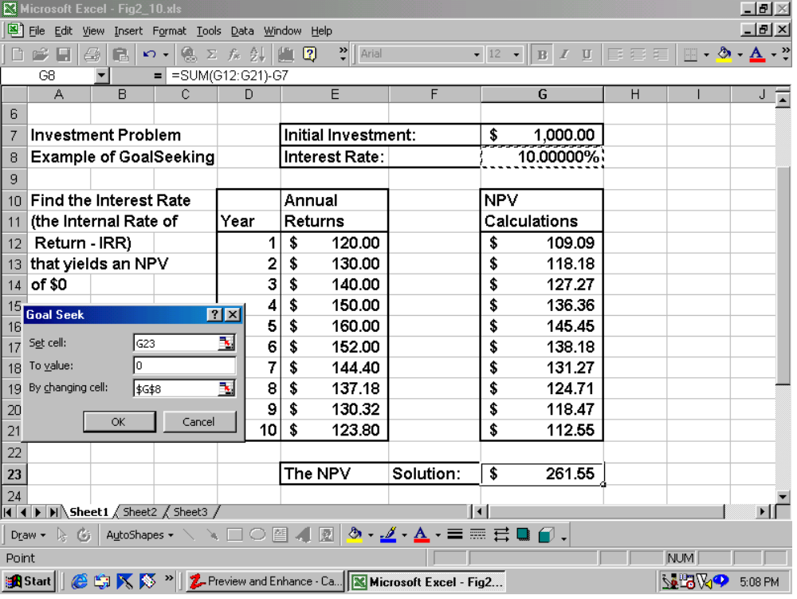
Goal Seeking
Decision Support Systems and Intelligent Systems, Efraim Turban and Jay E. Aronson, 6th edition,
Copyright 2001, Prentice Hall, Upper Saddle River, NJ

Slide 51
The Implementation Phase
There is nothing more difficult to carry out, nor more doubtful of success, nor more dangerous to handle, than to initiate a new order of things
(Machiavelli, 1500s)
*** The Introduction of a Change ***
Important Issues
Resistance to change
Degree of top management support
Users’ roles and involvement in system development
Users’ training
Decision Support Systems and Intelligent Systems, Efraim Turban and Jay E. Aronson, 6th edition,
Copyright 2001, Prentice Hall, Upper Saddle River, NJ

